Slide 1
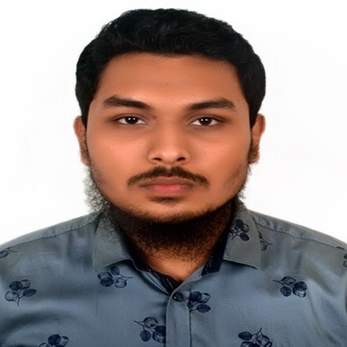
Sajidur Rahman
As a marketing major, my approach is guided by a creative and
dynamic mindset. As a diligent, goal-oriented team player, my
work consistently enhances and satisfies marketing objectives.

Slide 2



Education
Independent University, Bangladesh
Bachelor of Business Administration
Marketing
2022 – 2025
Feni Government College
Higher Secondary
Business Studies
2018 – 2019
Chhagalnaiya Academy
Secondary School
Business Studies
2016 – 2017
Provide background information about the education which includes institutions and education periods from Secondary School to Bachelor:

Slide 3


Work
ABC CO.
JAN 2023 - Present
Marketing Assistant
Here we identify consumer needs, satisfy consumer needs,
maintaining customer loyalty, and building customer
relationship
Provide information about the significant experience.

Slide 4
Licenses & Certification
Boost Up Your Career with LinkedIn
- IEEE W. E. [Jan 2023]
Introduction to Digital Journalism
- Reuters [May 2022]
Certificate of International Symposium
- International Global Network [Jun 2021]
Certificate of SPECPOL
- Asia Youth International Model United Nations [Jun 2021]
MUN 101 & MUN Simulation
- International Global Network [Apr 2021]
Certificate in National Skill Standard Basic Course Examination
- Bangladesh Technical Education Board [2018]
Explaining some certain set of criteria measured by a third-pity assessment.

Slide 5





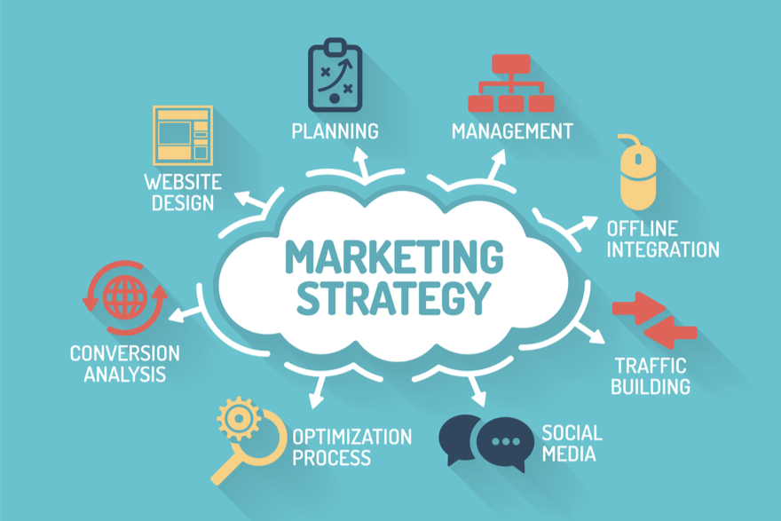



Skills
Market Research
Public Relation
Content Marketing
Brand Management
Writing and Editing
Promotional Strategies
Ability to execute or perform tasks efficiently and effectively.
Goal Oriented
Customer Acquisition
Office Application

Slide 6
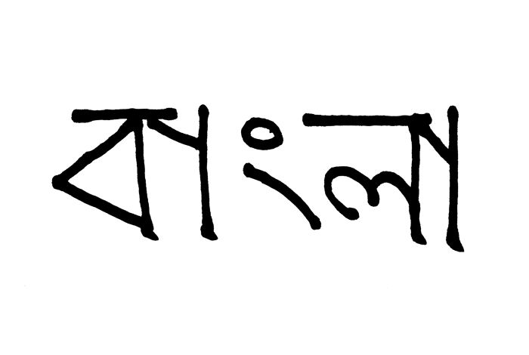

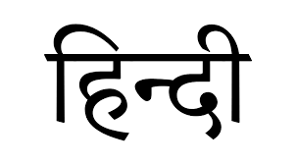
Languages
Bangla
Native or Bilingual Proficiency
English
Professional Working Proficiency
Hindi
Professional Working Proficiency
Credibility of communication.

Slide 7
Contact Information
Email : sajidurrhamna002@gmail.com
Mobile : +8801852-021694
Addresss : Bashundhara R/A, Dhaka 1229
LinkedIn : https://linkedin.com/in/sajidur-rahman-bangladesh
Website: https://direct.me/sajidurrahamn

